Slide 1
Geospatial Information Technology
at UOTP

Slide 2

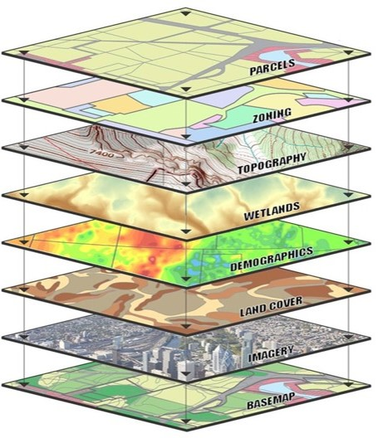
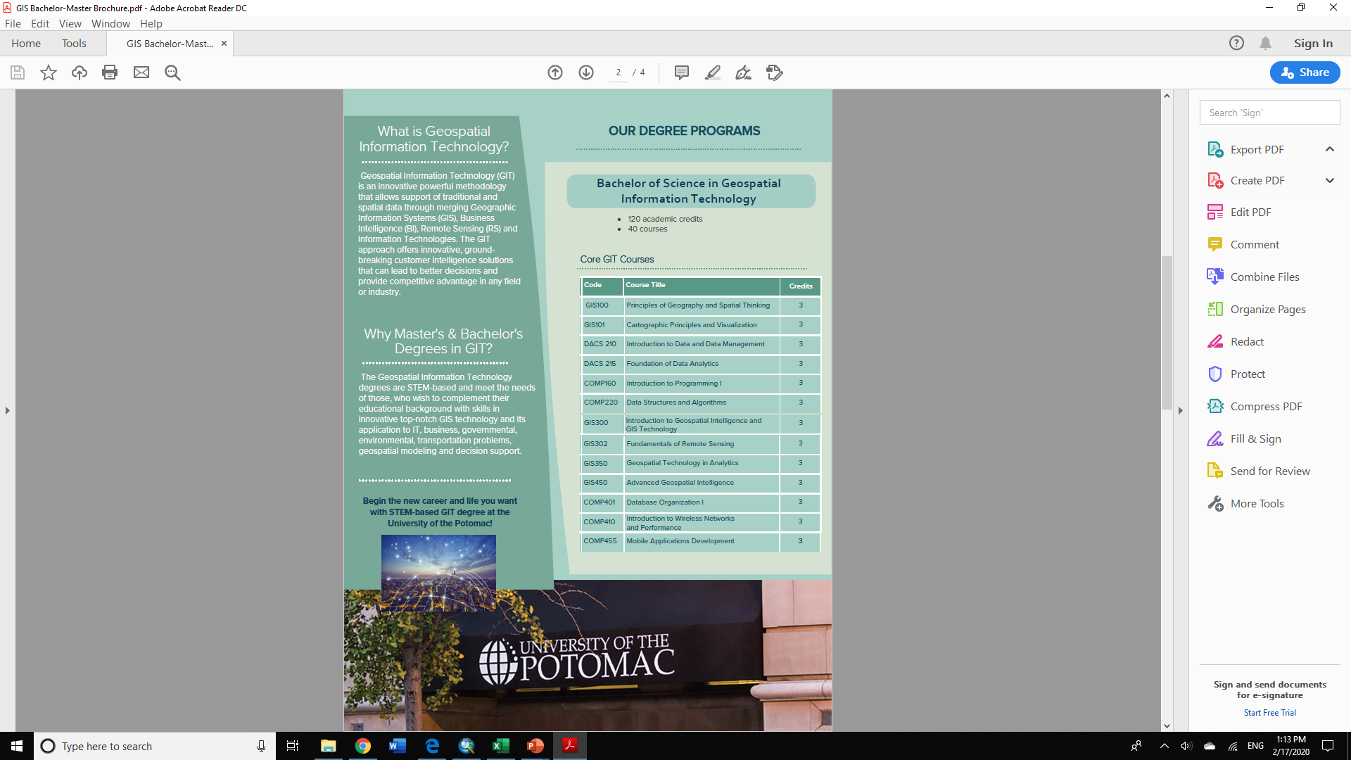
Geospatial Information Technology

Slide 3
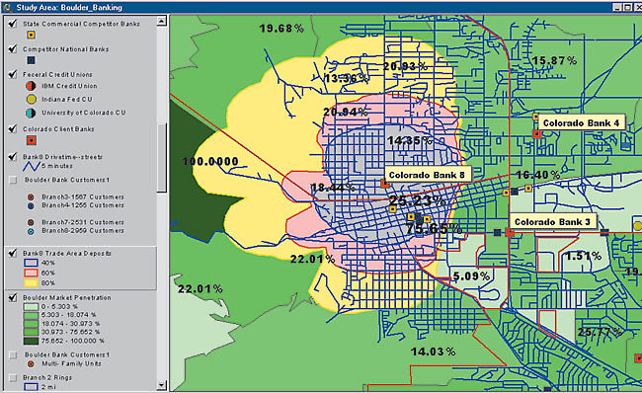
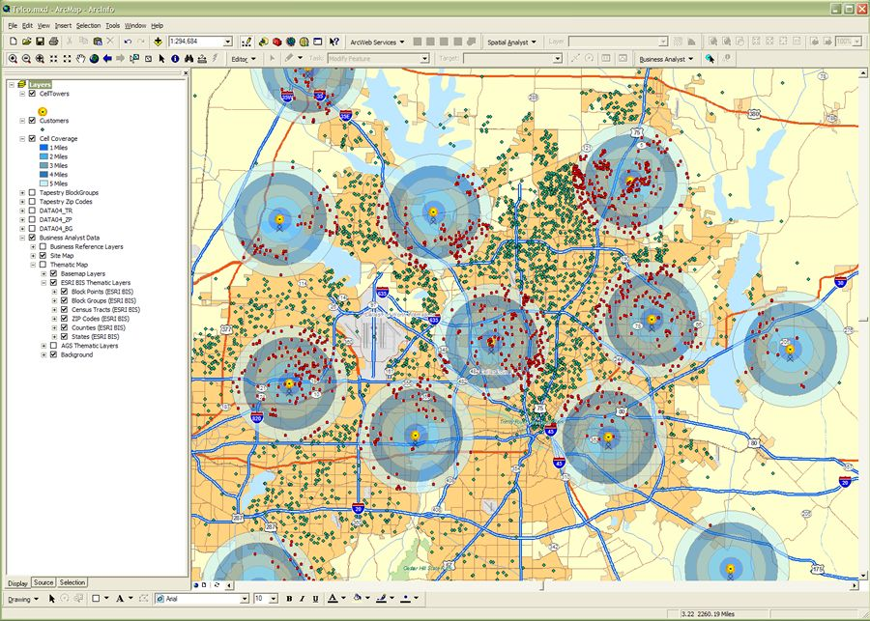
Geospatial Information Technology

Slide 4
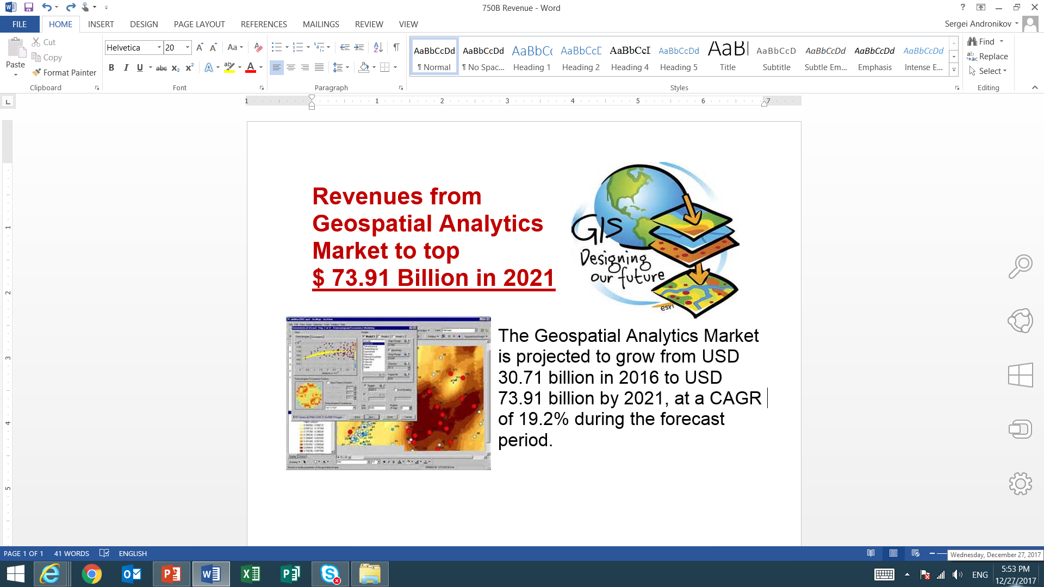
Geospatial Information Technology

Slide 5
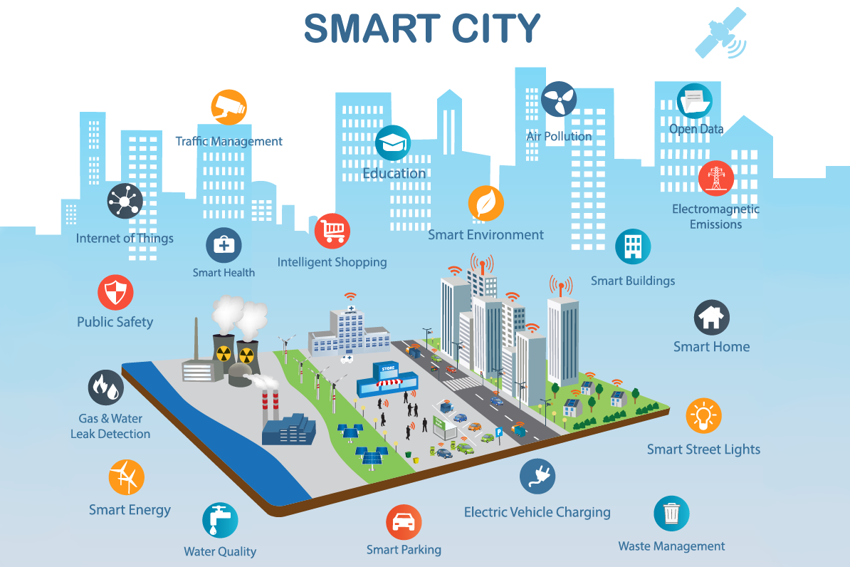
Geospatial Information Technology
According to Technavio, the smart cities market is projected to reach $1.2 trillion by 2021
Geospatial Technology
is a backbone
of Smart Cities

Slide 6
STEM-based
Geospatial Academic Programs

Slide 7
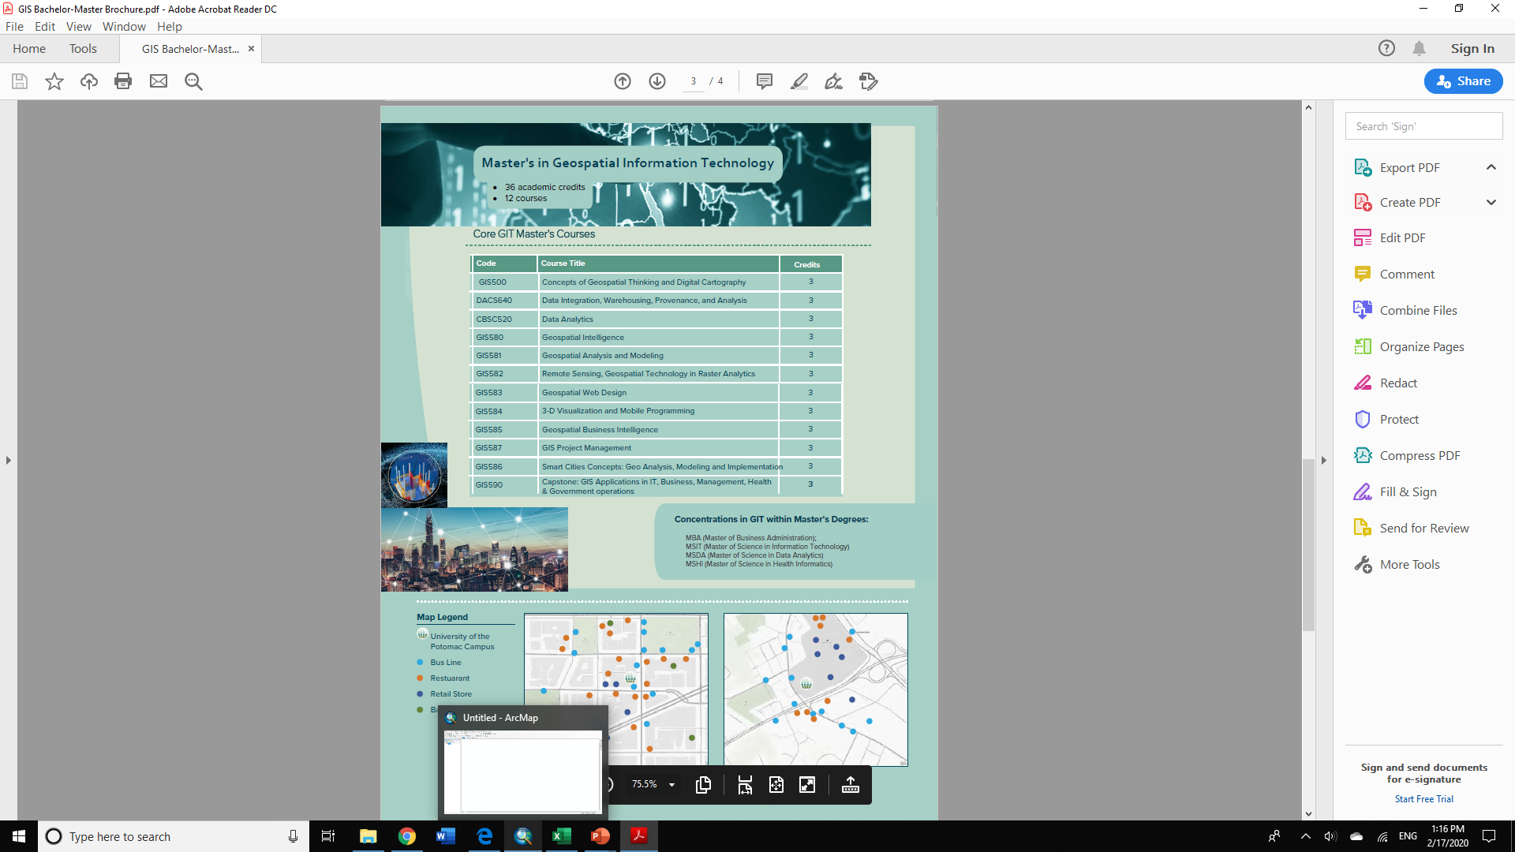
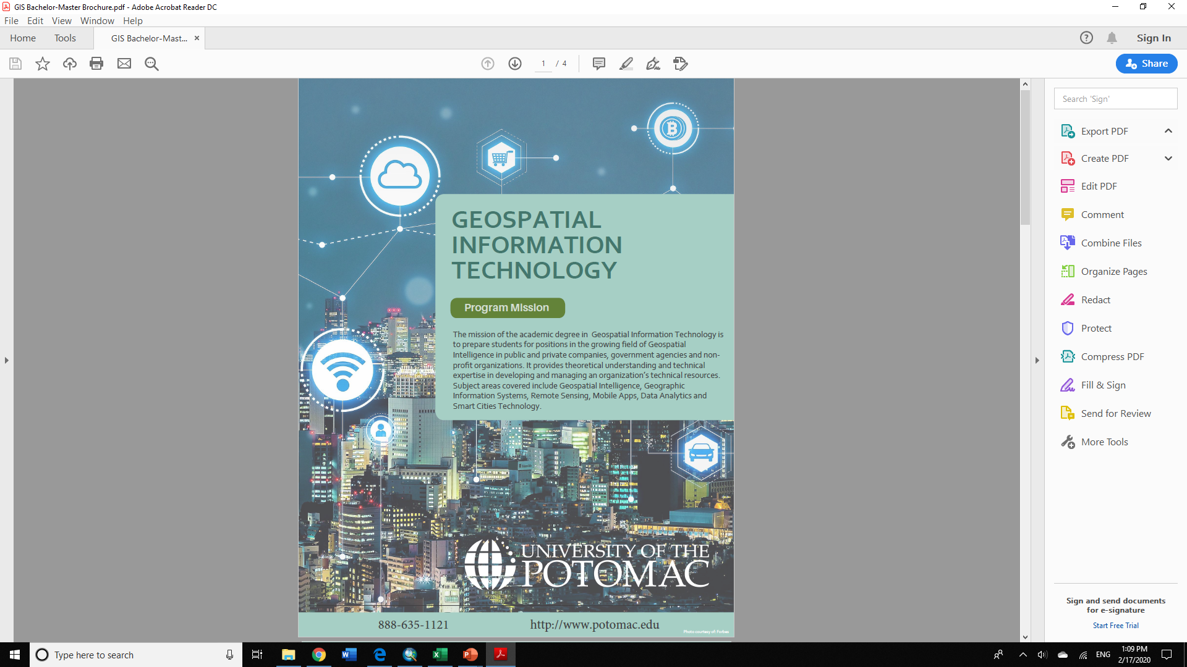
STEM-based Bachelor and Master’s degrees
in Geospatial Information Technology

Slide 8
Geospatial Executive Series

Slide 9

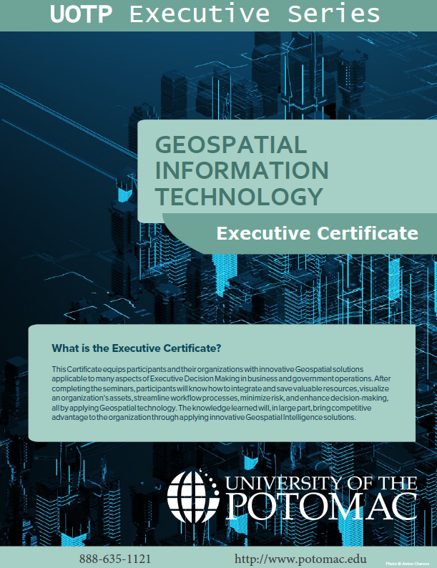
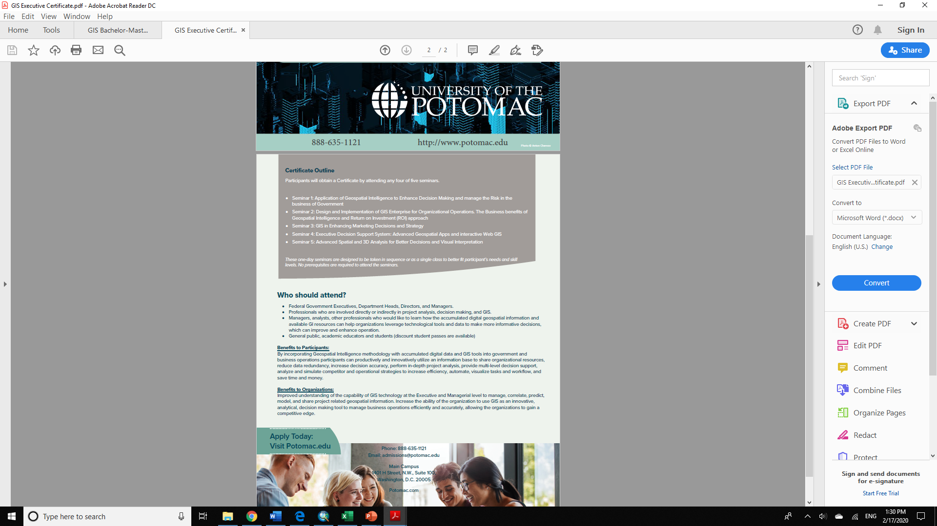
Geospatial Executive Training

Slide 10
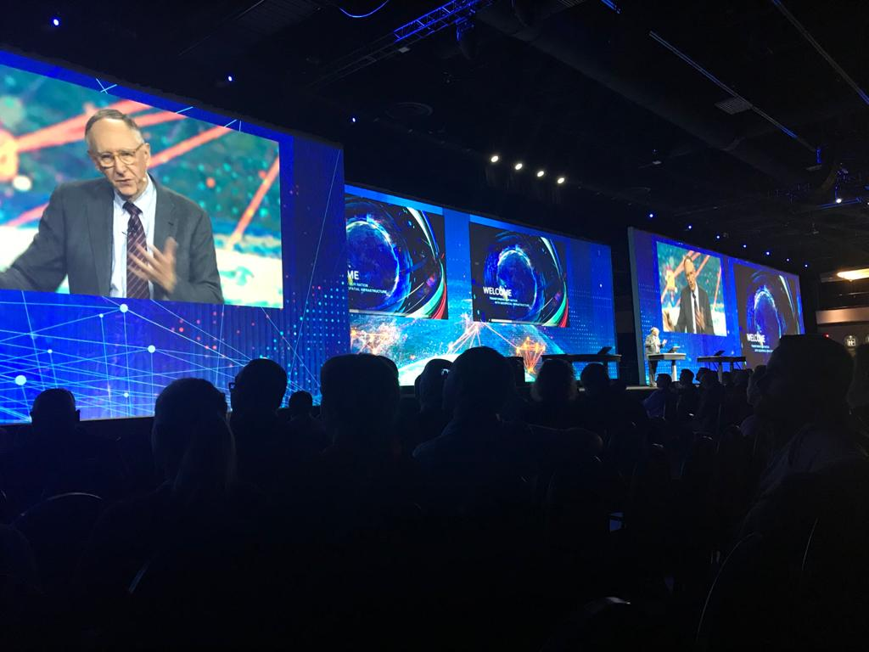
Geospatial Federal User Conference
Washington, D.C. Convention Center, February 11-12, 2020
23rd annual Federal GIS Conference
Over 5000 attendees
76 companies
Over 130 professional Workshops
University of the Potomac chosen one of the six US universities to present at University Zone

Slide 11
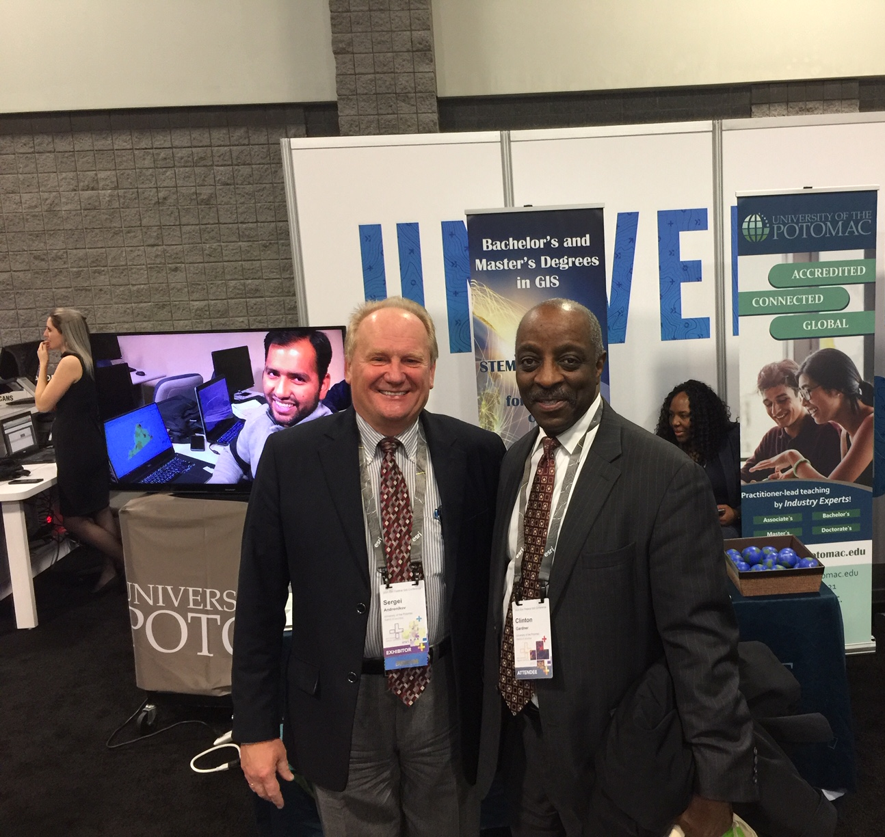
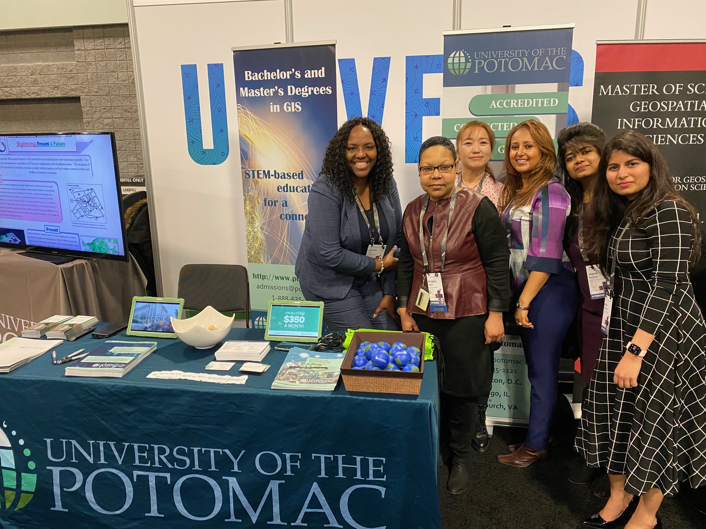
Geospatial Federal User Conference
Washington, D.C. Convention Center, February 11-12, 2020
Photo (from left): Dean of Academic Affairs Dr. Sergei Andronikov and UOTP President Dr. Clinton Gardner
Photo (from left): UOTP COO Andrea Ford, Admission Assistant Director Kimberly Moses, Professor Sara Hummell, Academic Affairs Specialist Seblewengel Teklehaimanot, Student Worker Joyce Munigety, , Academic Affairs Specialist Asha Kodathala

Slide 12
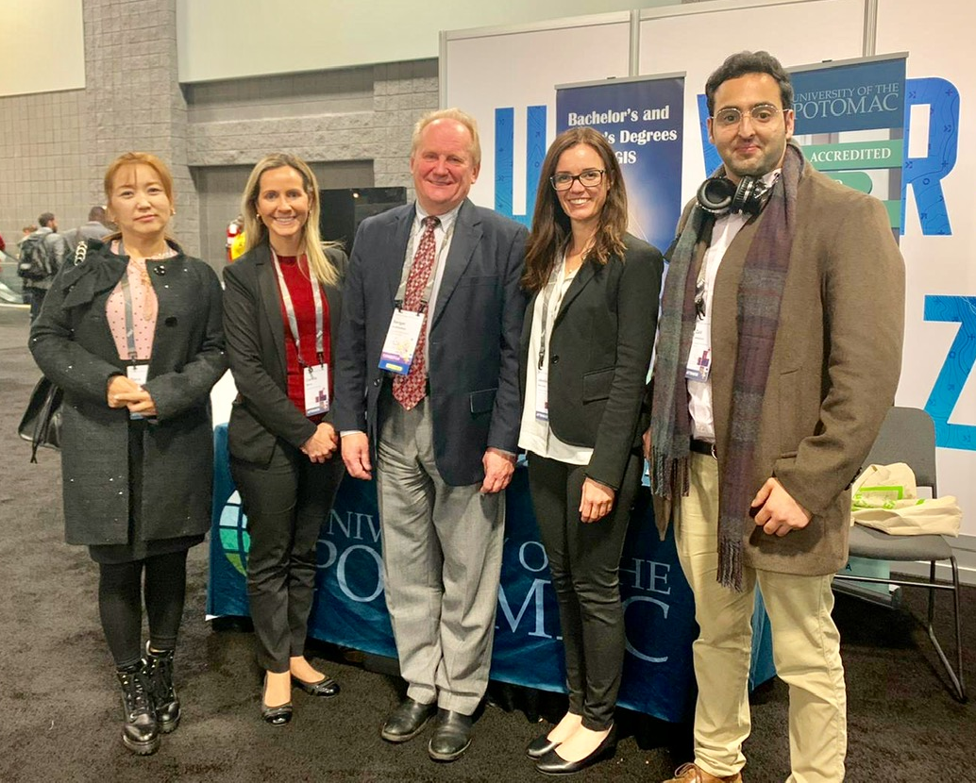
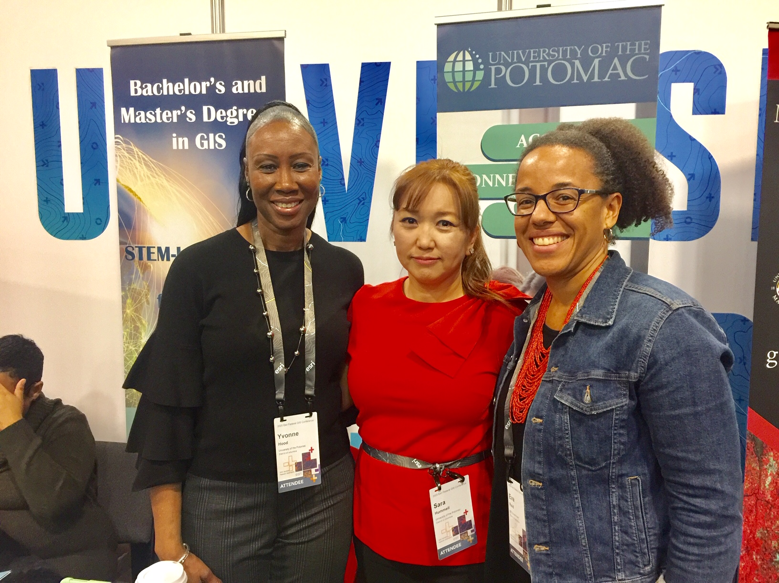
Geospatial Federal User Conference
Washington, D.C. Convention Center, February 11-12, 2020
Photo (from left): Professor Sara Hummell, Campus Manager Camila Meros, Dean of Academic Affairs Dr. Sergei Andronikov, Student Worker Joyce Munigety, GIS Student Zaid Alshaboul
Photo (from left): Associate Dean Yvonne Hood, Professor Sara Hummell and Eva Reid at Women in GIS Group Networking

Slide 13
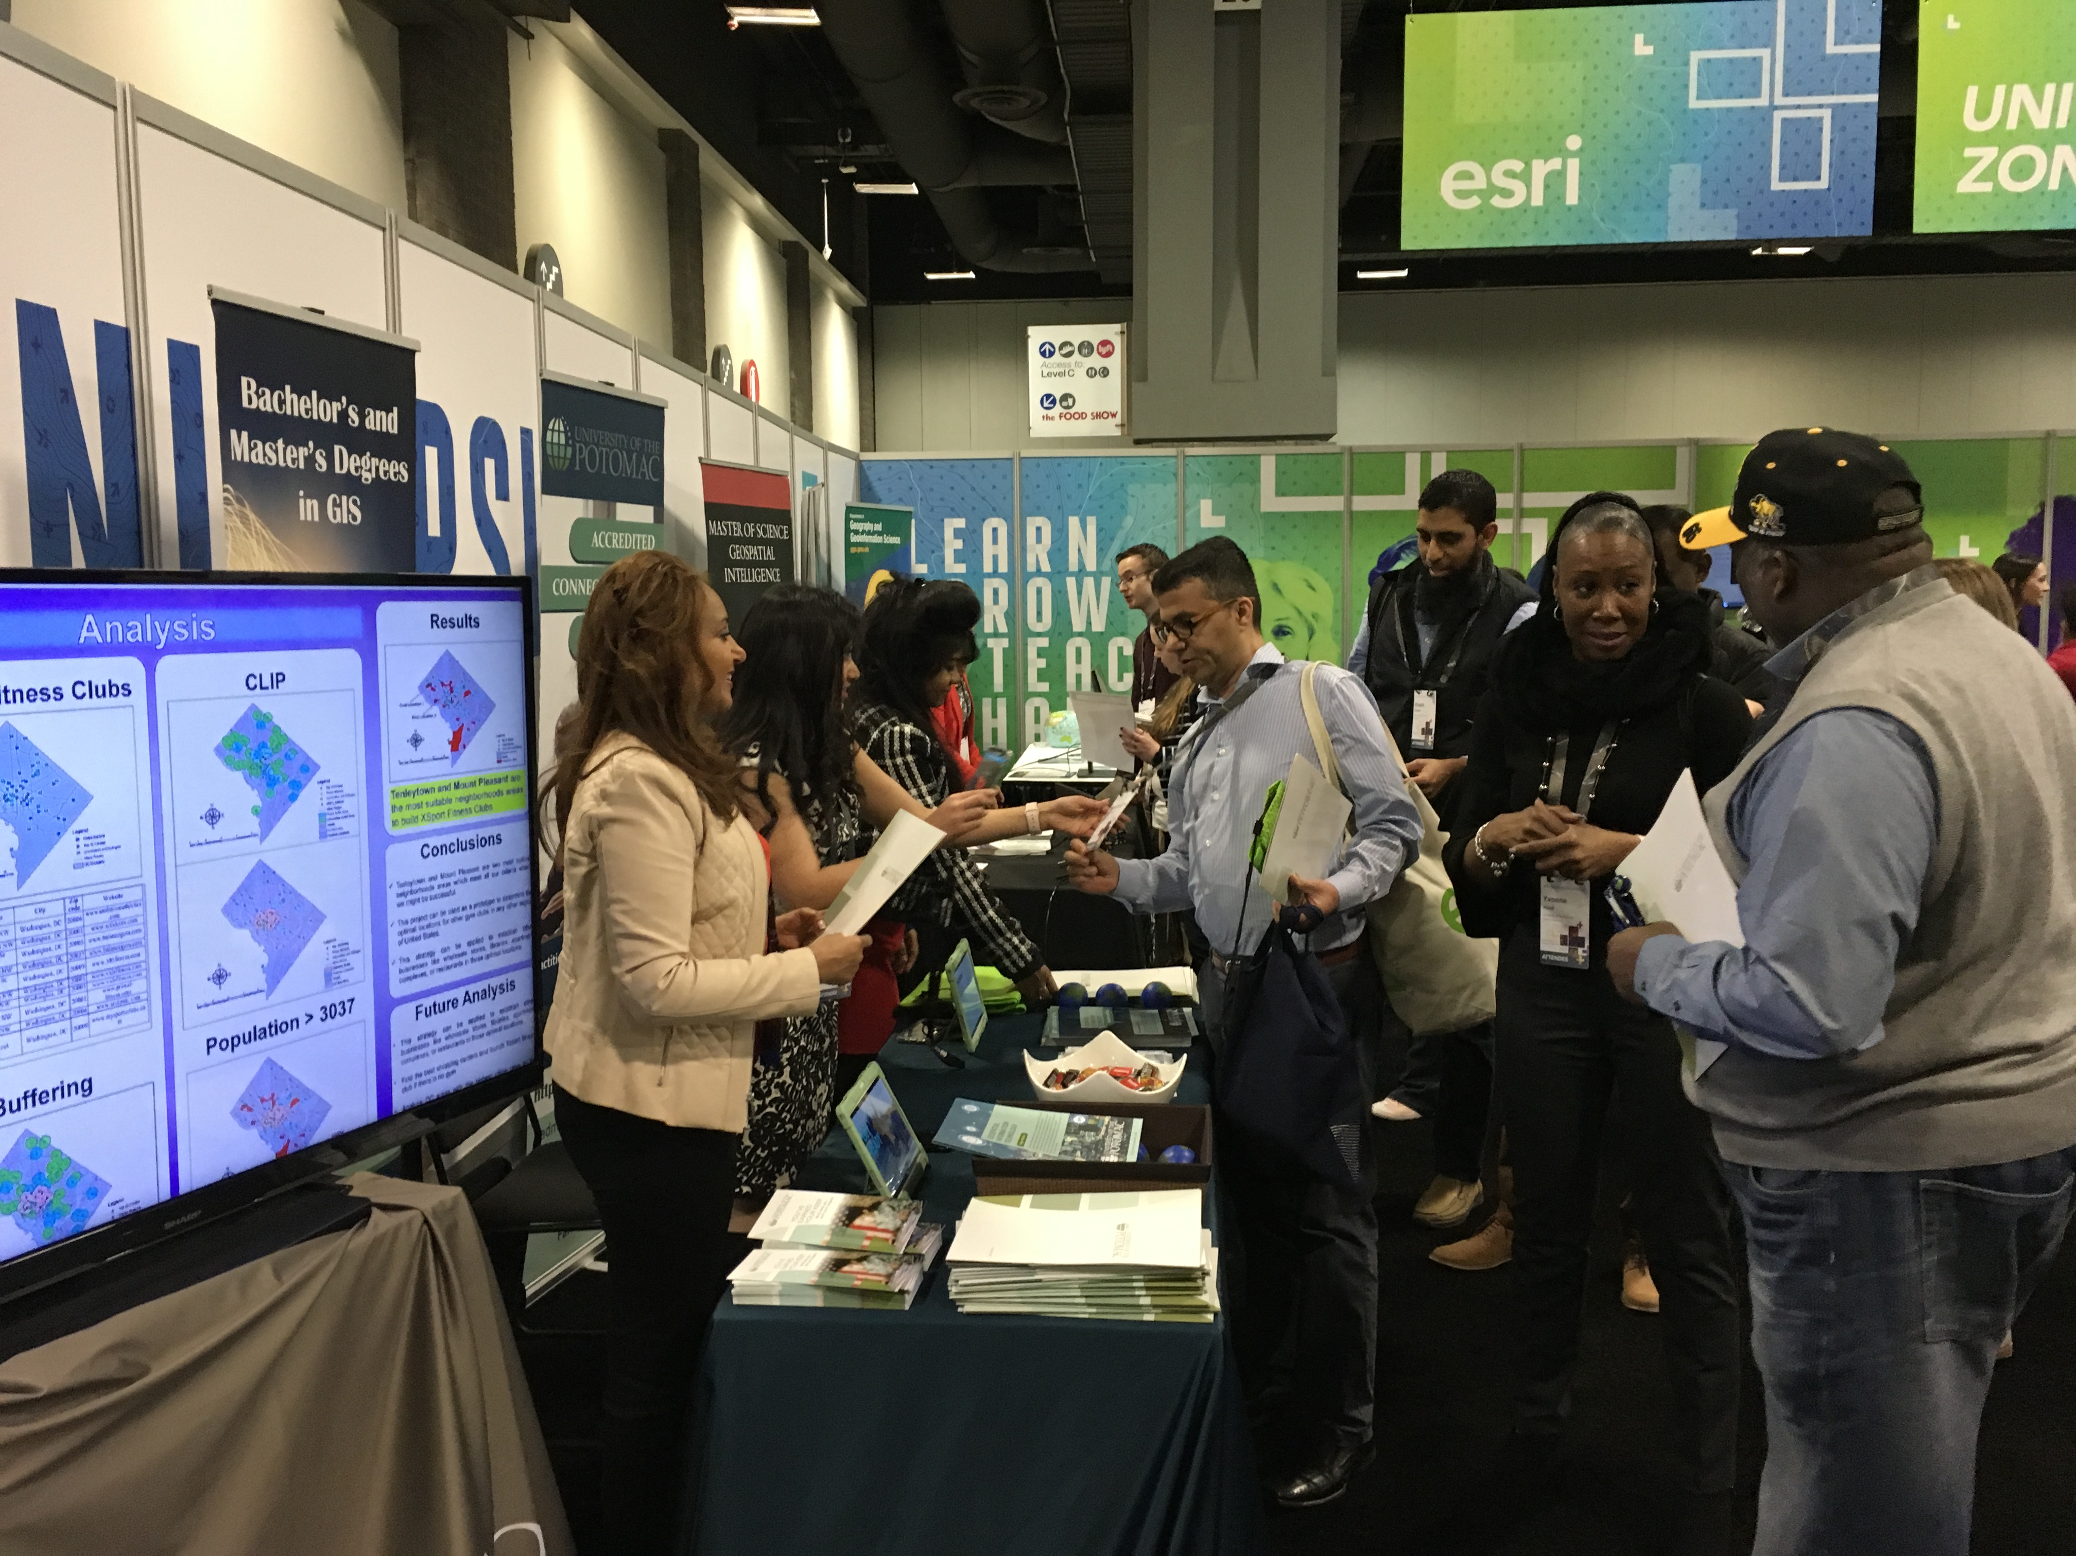
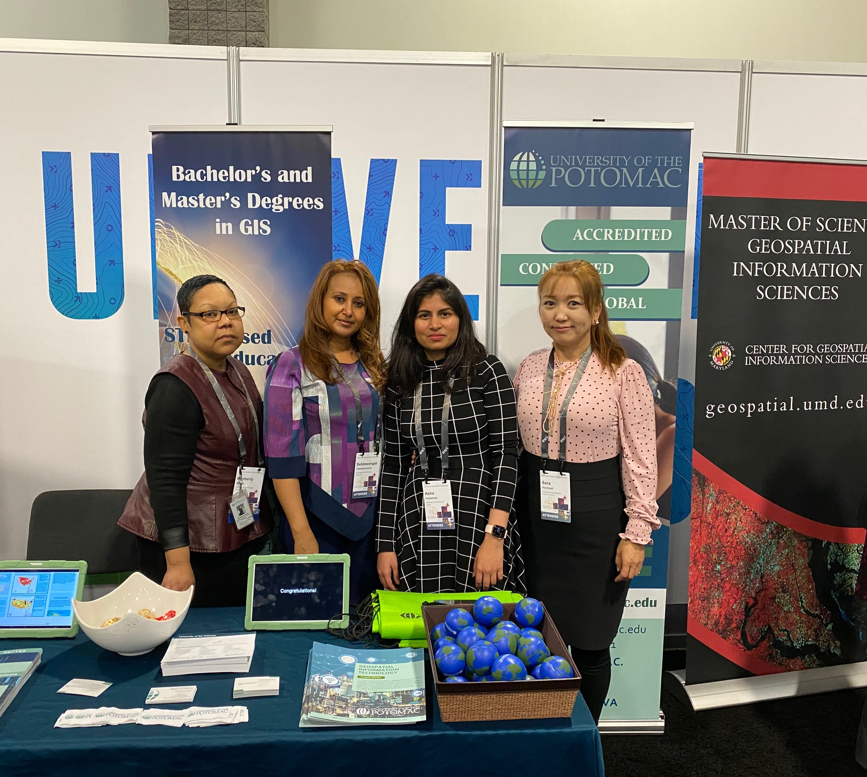
Geospatial Federal User Conference
Washington, D.C. Convention Center, February 11-12, 2020
136 participants stopped at University of the Potomac booth
Photo (from left): Admission Assistant Director Kimberly Moses, Academic Affairs Specialist Seble Teklehaimanot, Academic Affairs Specialist Asha Kodathala, Professor Sara Hummell

Slide 14
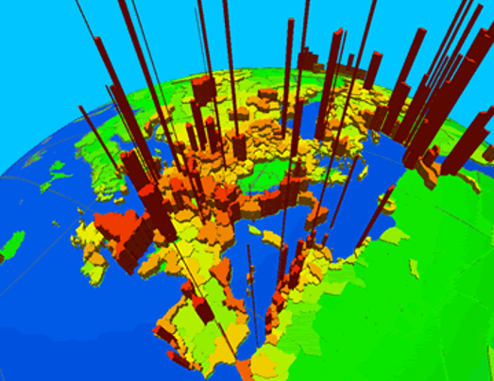
Begin the new career with innovative Geospatial Information degree!

